Slide 1
Building a Restorative Academy
Presented by
The Crawford High School
Academy Of Law

Slide 2
Something to Consider…
“If a child doesn’t know how to read, we teach.”
“If a child doesn’t know how to swim, we teach.”
“If a child doesn’t know how to multiply, we teach.”
“If a child doesn’t know how to drive, we teach.”
“If a child doesn’t know how to behave, we….?”
“Why can’t we finish the last sentence as automatically as we do the others?”
Tom Herner (NASDE President ) Counterpoint 1998, p.2

Slide 3
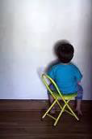
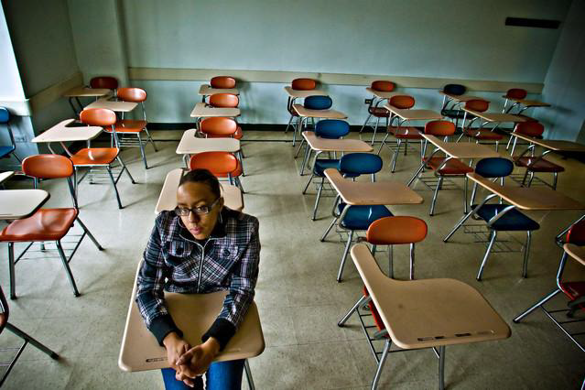
What we think suspensions accomplish…
I LEARNED MY LESSON
I WILL NEVER DO IT AGAIN

Slide 4
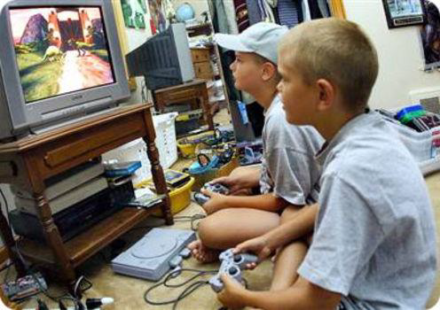
What suspensions actually accomplish…
“Hey girl, what are you doing after school?”
“I just beat my high score!”

Slide 5
Students Scoring Proficient or Above on CST ELA and Math in Relation to Number of Times Suspended Annually Grades 2-11, District-Managed Schools (2010-13)
MATH
ENGLISH LANGUAGE ARTS
% Proficient
% Proficient

Slide 6
What is Restorative Justice?
Restorative Justice is…holding offenders directly accountable to the people they have violated, and providing a range of opportunities for dialogue, negotiation and problem-solving, which can lead to a greater sense of community safety, social harmony and peace for all concerned
(Mark Umbreit, 1996)

Slide 7
Restorative Practices

Slide 8
Moving Towards a Restorative Model
A restorative model…
Focuses on building a strong sense of community
Finds a balance between firmness and fairness
Emphasizes accountability and repairing harm
Teaches necessary skills such as
Self-regulation
Communication
Empathy
People who share a strong sense of community are far less likely to violate the trust of other community members.
Restorative Justice is, therefore, both
Preventive
Corrective

Slide 9
What do we really care about?
Traditional Approach
What rule/law/policy was broken?
Who broke that rule?
How should they be punished? What punishment do they deserve?
Restorative Approach
What is the harm that was done?
How can that harm be repaired?
Who is responsible for this repair?

Slide 10
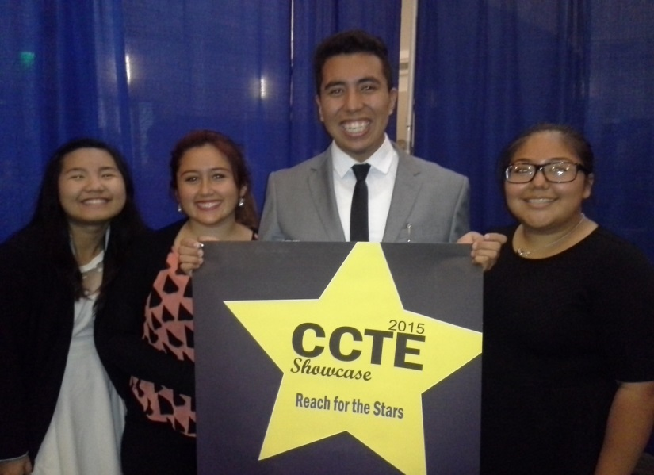
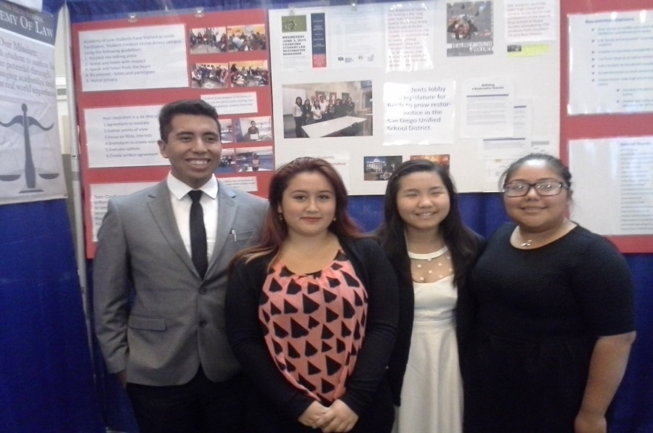
The Let’s R.O.C Project Crawford Academy of Law
The Principals of Restorative Justice…
Repair the Harm
Offender Accountability
Community Safety

Slide 11
Let’s R.O.C. at Crawford

Slide 12
New Approach is Proven Successful

Slide 13
How is Crawford making the shift to a restorative model?
Focusing on three areas:
Restorative Circles
Peer Mediation
Teen Court
Changing Teacher Mindsets

Slide 14
Restorative Circles

Slide 15
Restorative Circles at Crawford
Fall - 12th Graders facilitate weekly circles with 9th, 10th and 11th graders…
Advisory
Fall - 11th Graders are trained in facilitating circles by staff from the National Conflict Resolution Center (NCRC)
12th graders serve as mentors to 11th graders
Spring – 11th graders facilitate circles across the campus for non-Academy classes
Support from 12th graders and NCRC
Academy teachers use circles regularly in the classroom

Slide 16
Peer Mediation at Crawford
Training: Academy of Law students are trained by NCRC in Peer Mediation in the 11th grade
Student Volunteers: 11th and 12th grade Academy students volunteer to serve as Peer Mediators
Referrals: Administrator and teachers refer students for Peer Mediation
Peer Mediation Referral Form
Goal: Students will self-refer when there is a conflict…
More campus-wide awareness

Slide 17
The Peer Mediation Process
Students must agree to mediate
Mediators listen to each disputants’ side of the story;
Mediators focus on the underlying interests of each disputant;
Mediators create win-win options;
Mediators evaluate options;
Mediators and disputants create an agreement;
Mediators fill out a Peer Mediation Agreement;
Disputants sign the agreement…
Everyone lives happily ever after?

Slide 18
Teen Court
What is Teen Court?
Teen Court is a youth diversion program that is run in conjunction with the Superior Courts and S.A.Y. San Diego
Available to first time misdemeanor juvenile offenders in lieu of Juvenile Court;
Offenders admit guilt and agree to a “trial” by a jury of peers.
Student jurors receive training on the principles of restorative justice;

Slide 19
Teen Court, cont.
During the “trial” students ask the offender and his/her parents salient questions;
Student jurors determine the consequences for the offender based on the principles of restorative justice;
Community service
Educational classes
Letters of apology
Offenders have 90 days to complete the consequences
Offenders who successfully complete consequences have their criminal record expunged.

Slide 20
A Restorative Approach to Teaching
Moving from this… to this…

Slide 21
What can teachers do to model a restorative approach in the classroom?
Actively listen and practice empathy;
If We Could See Inside Others’ Hearts
Use choice words / choice statements;
Affective Statements, a.k.a. “I” Statements
Ex. I feel concerned / disrespected / proud / excited when you…
Affective Questions to address challenging behavior or to help those affected.
Consistently provide students with opportunities to be heard
Restorative circles
Restorative conferences

Slide 22
Affective Questions
When Behavior is Challenging:
What happened?
What were you thinking at the time?
What have you thought about since?
Who has been affected by what you have done? In what way have they been affected?
What do you think you need to do to make things right?
RestorativeWorks.net

Slide 23
Affective Questions
To Help Those Affected:
What did you think when you realized what had happened?
What impact has the incident had on you and others?
What has been the hardest thing for you?
What do you think needs to happen to make things right?
RestorativeWorks.net

Slide 24
How can I use restorative circles in my class?
Getting to know your students;
Identifying strengths/weaknesses in content knowledge;
Checking in before a big test or assignment
Addressing classroom behavior;
Victim/Offender
General issues – disrespect, tardiness, late work
Discussing controversial or traumatic events that have affected the school / community / nation / world

Slide 25
Tips for Facilitating Restorative Circles
Establish ground rules/norms;
Use a talking piece;
The shape of the circle matters;
Circles are NOT just for disciplinary situations;
Always start with a low risk, “check-in” question or ice breaker
The Way the Wind Blows
Work up to more intense /revealing questions;
Teachers should always answer the questions too! You are the model for appropriate participation and your voice matters.

Slide 26
Restorative Practices Can Bring Us All Together

Slide 27
Acknowledgement and Thanks
With gratitude for their hard work and dedication…
Steve Luttbeg – Former teacher, Project lead on Let’s R.O.C.
Justine Darling – Restorative Practices Coordinator, NCRC
Jenn Vermillion – Restorative Practices School Specialist, NCRC
Dr. Joe Fulcher – Former Director of Student Services,
San Diego Unified School District
Super Star Seniors – Alan, Phuong, Larissa, Mey, Edith, Sarina
The National Conflict Resolution Center (NCRC)
S.A.Y. San Diego
San Diego Unified School District

